Slide 1
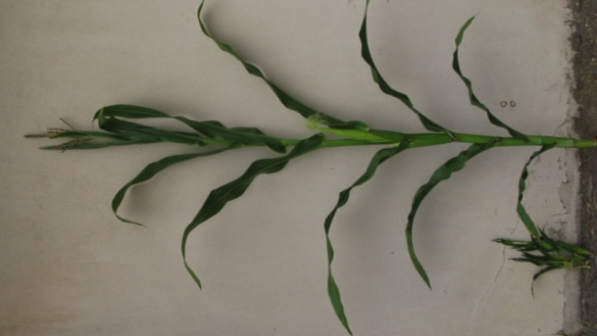
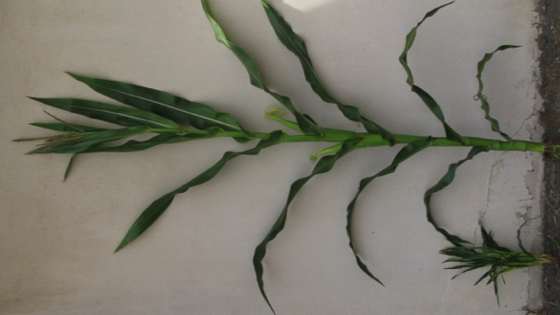
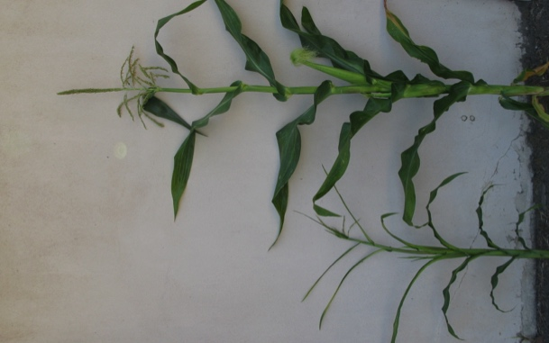
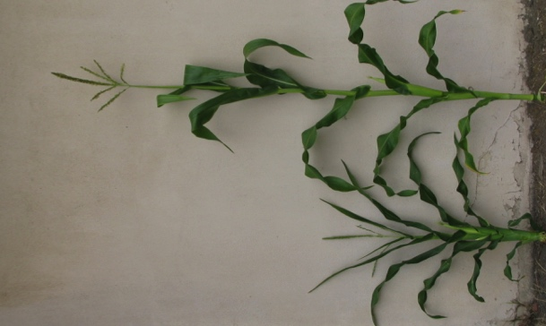
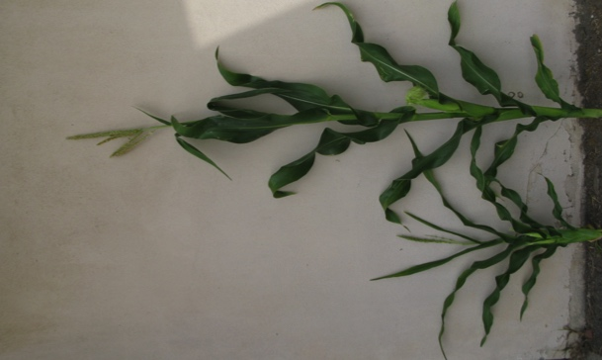
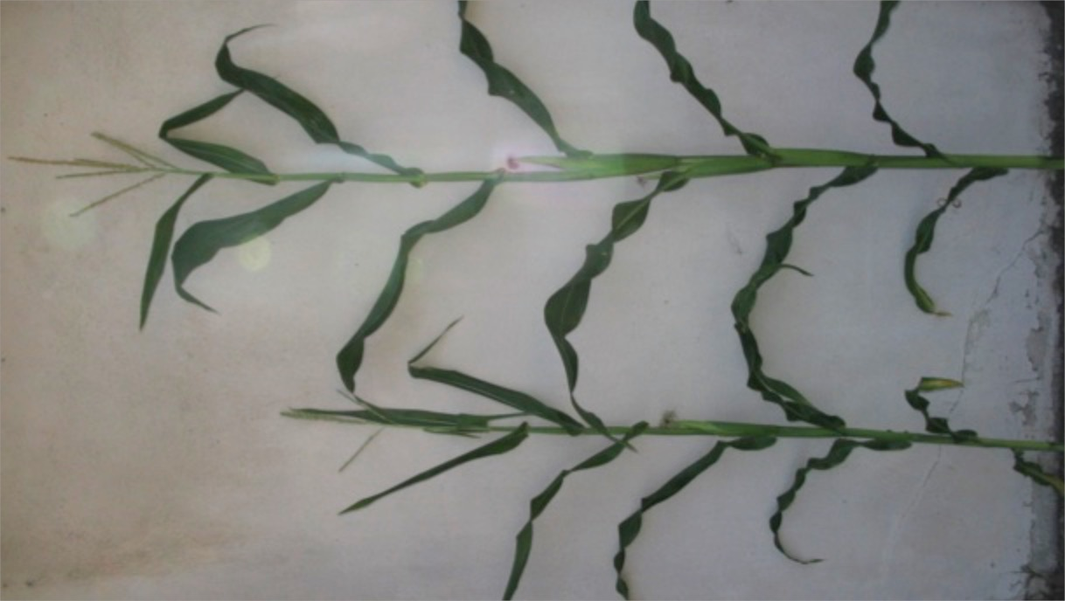
The phenotype of nod is dependent on inbred background
B73/nod-1
B73/nod-RS
W22/nod-1
A619/nod-1
A619/nod-RS
Mo17/nod-RS
-/-
+/+
-/-
+/+
-/-
+/+
-/-
+/+
-/-
+/+
-/-
+/+

Slide 2
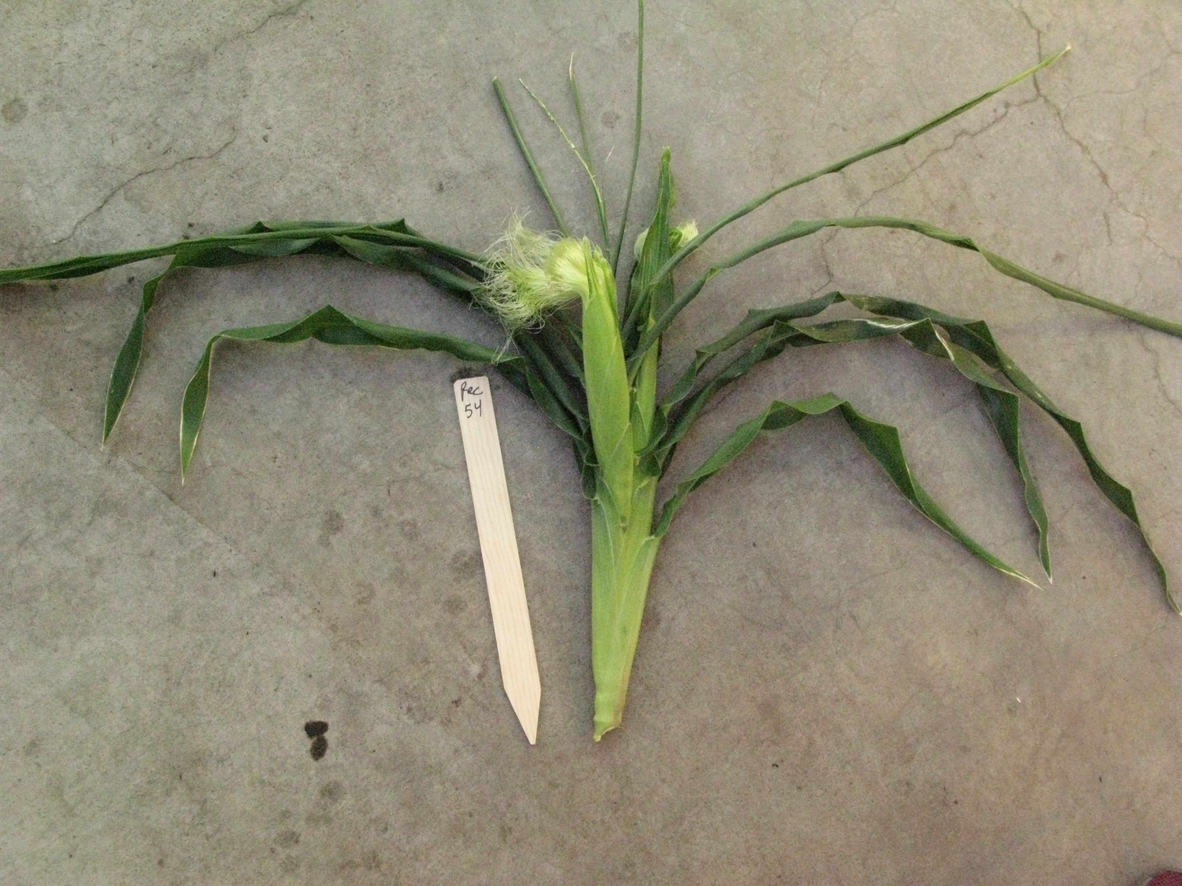


Marisa Rosa
Jazmin Abraham-Juarez
narrow odd dwarf (nod)
Short internodes, ears ok, tassel sparse, leaves narrow
Notes:
But you don’t actually see the phenotype until bolting (unless you carefully measured the leaf widths

Slide 3
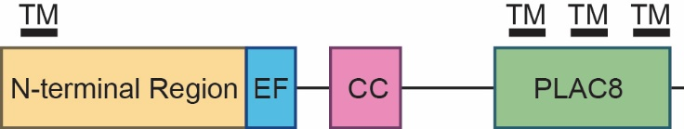
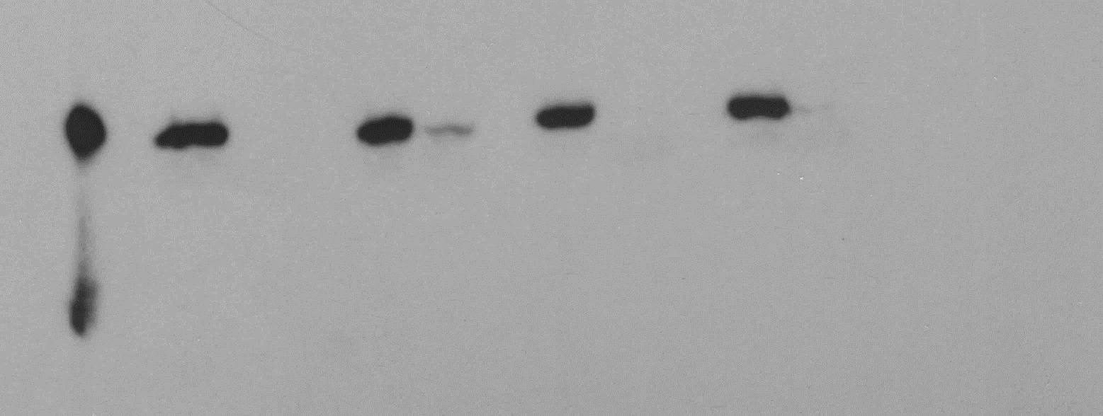
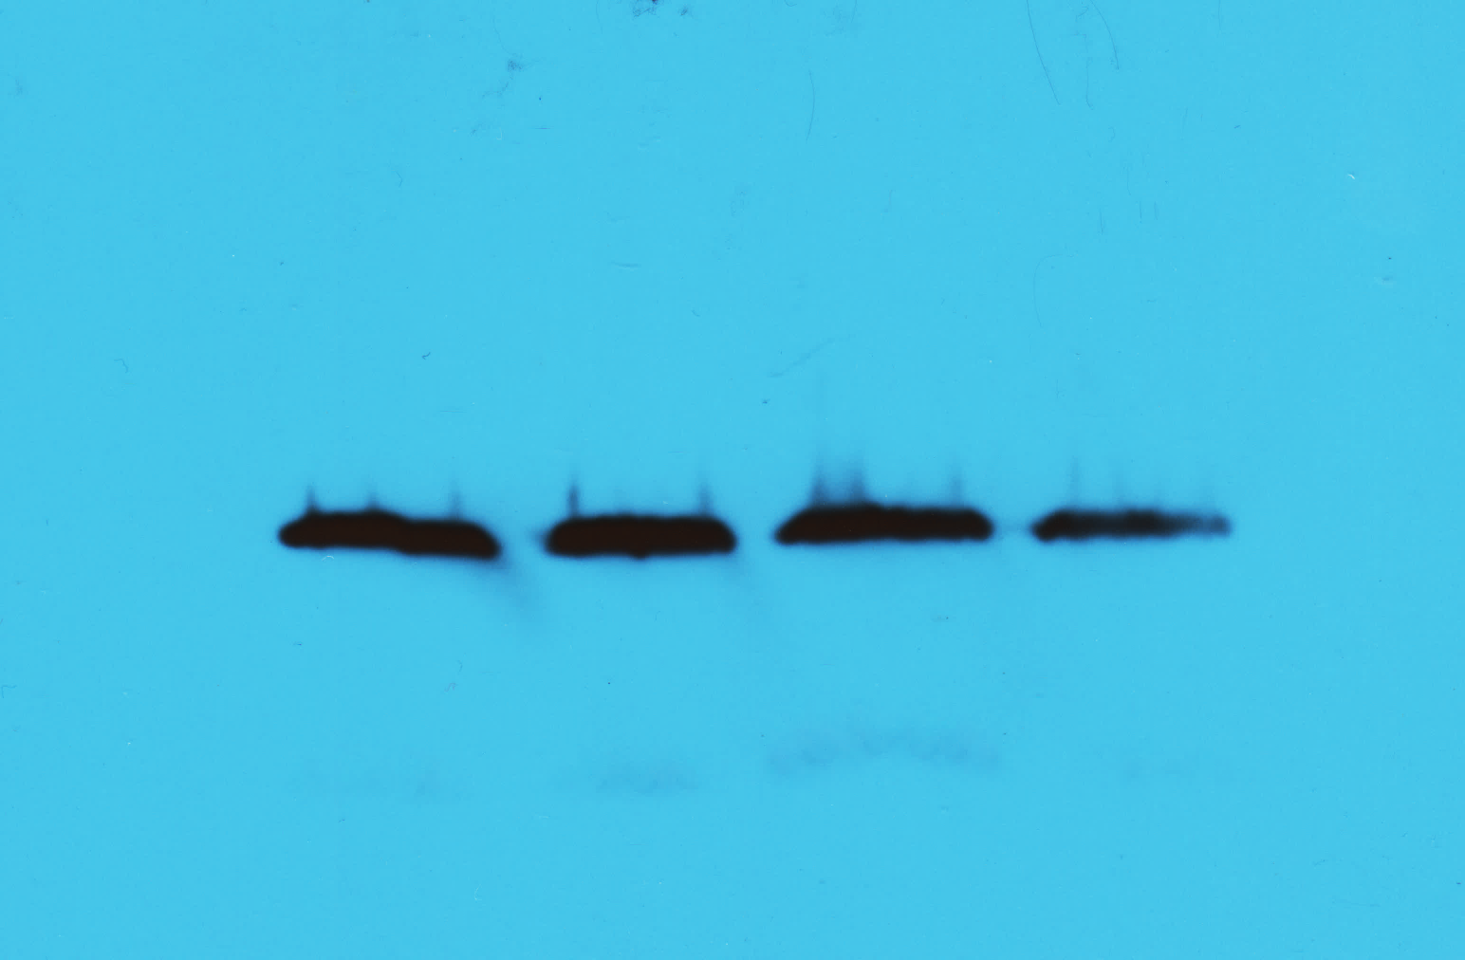
narrow odd dwarf (nod) cell number regulator13 (fw2.2 family) aka maize MCA (mid-complementing activity)
.
Implicated in Ca²⁺ signaling
2 alleles
RecNOD wt-1 nod-1 wt-RS nod-RS
NOD
TUB
Rosa et al., 2017
Notes:
yeast mid1 mutant lacking a putative Ca2-permeable stretch activated channel component.

Slide 4
to understand NOD function we carried out immunoprecipitation using the NOD antibody followed by mass-spec
In every experiment NOD was found in wild-type precipitation and not in mutant precipitation
Categories include Calcium related, plasma membrane localized and kinases

Slide 6



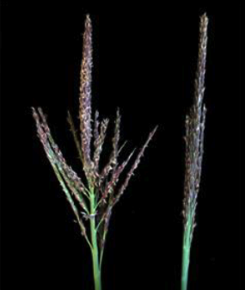
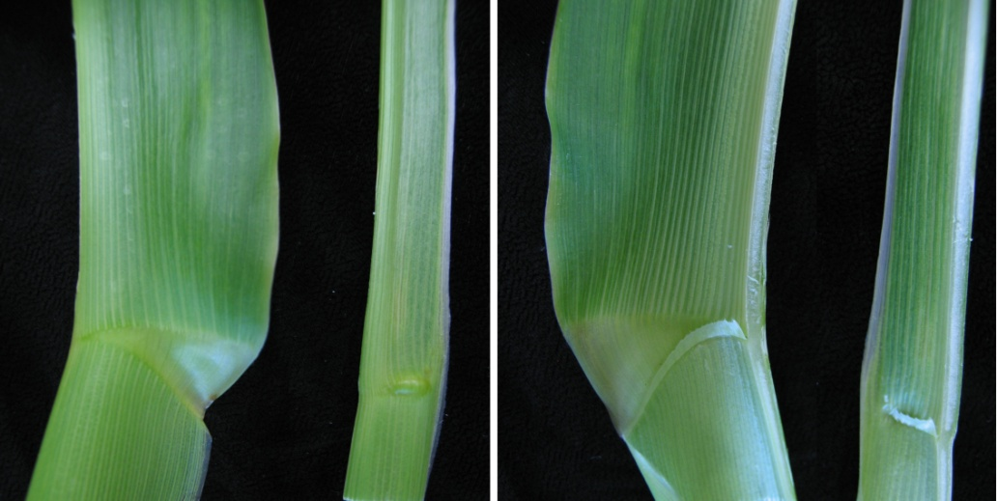
Lgn-R/+
Narrow leaves, reduced ligule, upright tassel branches
blade
ligule
sheath
auricle
Wild-type Lgn-R/+ Wild-type Lgn-R/+
Notes:
Emphasize the pleiotropy of this mutation.

Slide 7
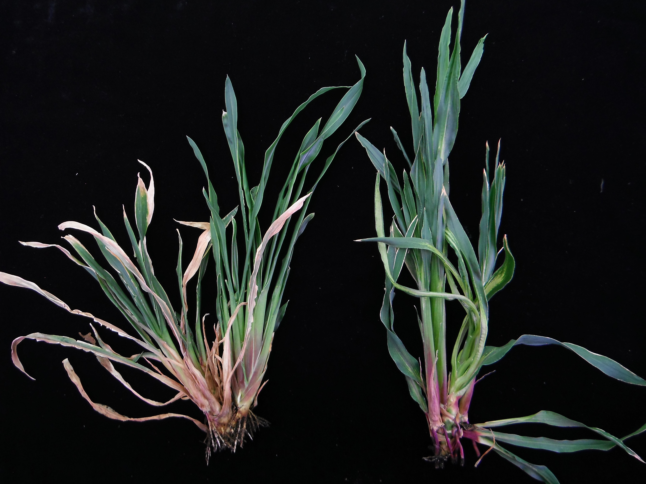
Lgn-R homozygote looks similar to nod homozygotes when they are both in B73
Lgn-R/Lgn-R nod/nod(B73)
Plants at maturity

Slide 8
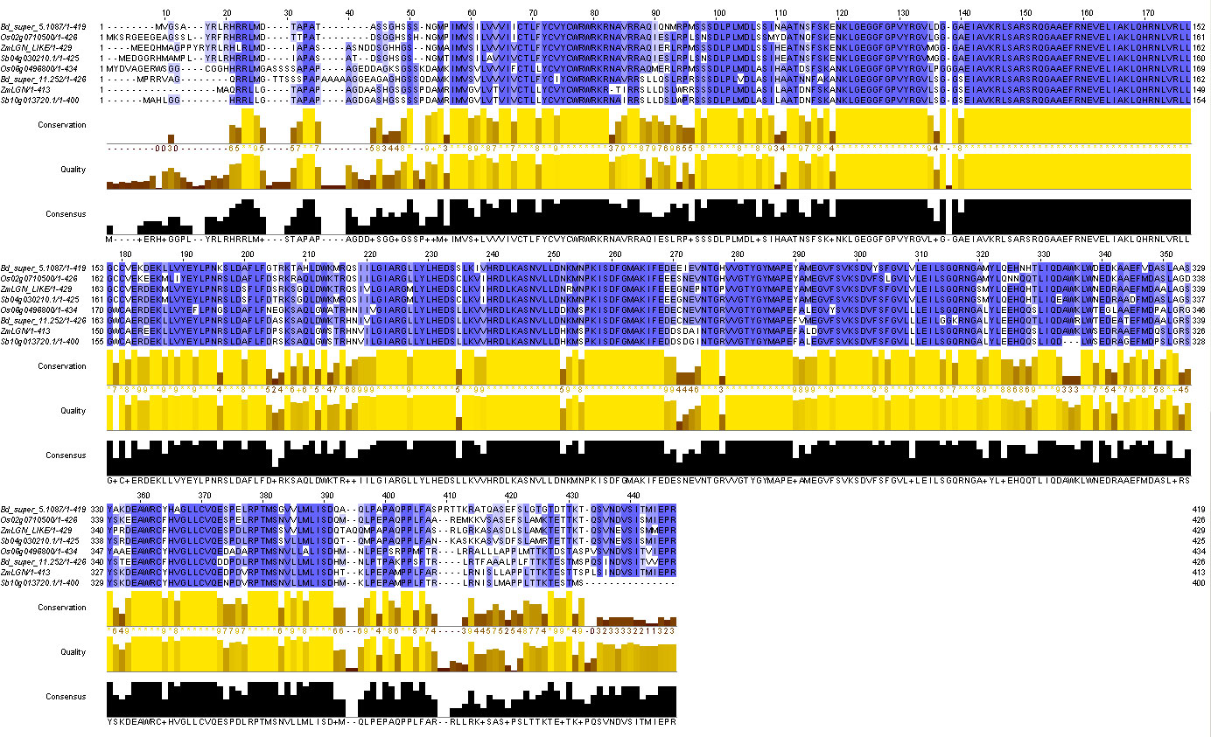
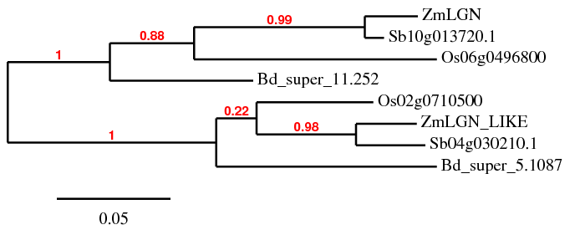
LGN genes are duplicated in the grasses
(A)
(B)
Lgn-R
A138T
TMD Kinase
(C)
OsLGN
BdLGN-like
OsLGN-like
ZmLGN-like
SbLGN-like
BdLGN
ZmLGN
SbLGN

Slide 9
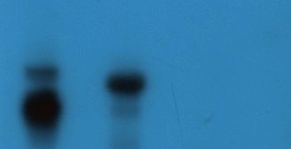
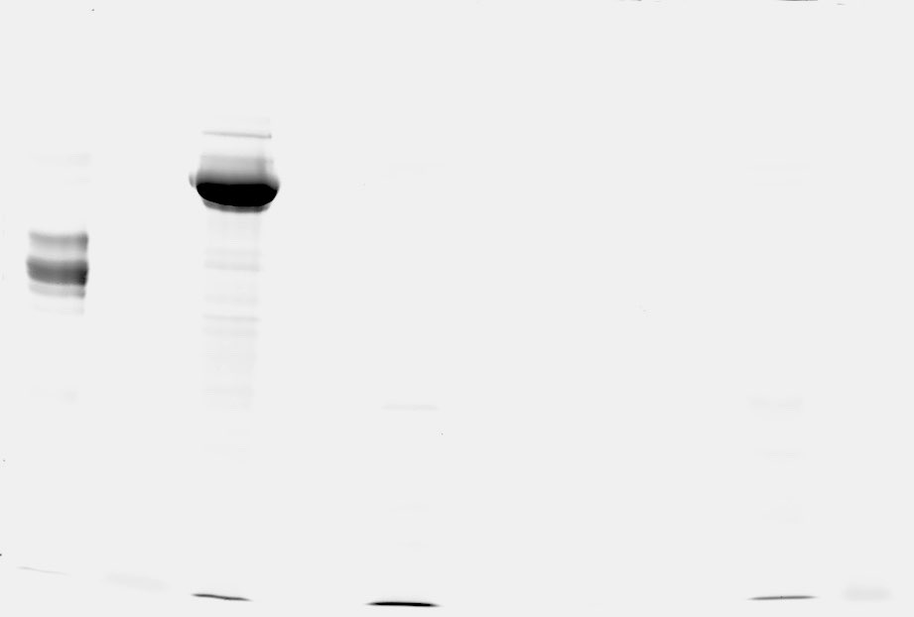
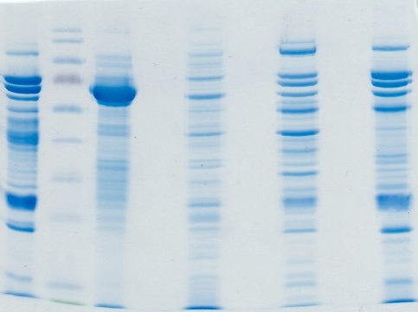
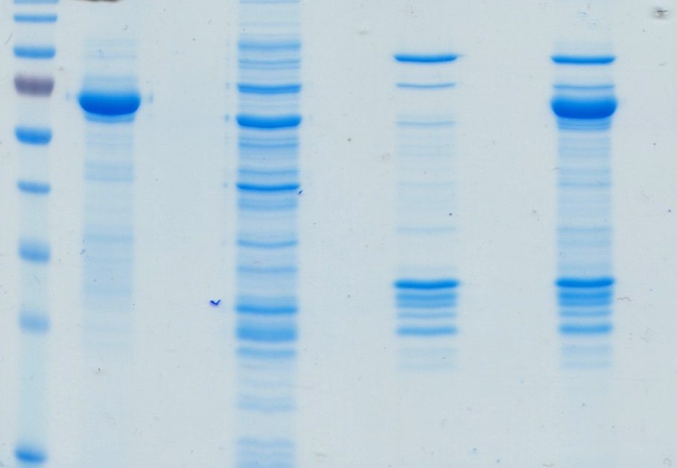
LGN and the duplicate, LNL, encode kinases.
The mutant is kinase defective
LNL LGN LGNA138T
LNL LGN LGNA138T
LNL LGN LGNA138T
*
*
*
Radioactive assay
ProQ Diamond staining
Coomassie staining
Recombinant proteins:
LNL - Liguleless narrow like
LGN - Liguleless narrow
LGNA138T - Liguleless narrow A138T
The dominant LGN-R (A138T) may block phosphorylation by the normal copy
9

Slide 10
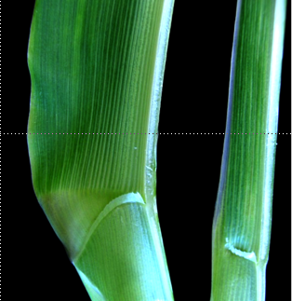
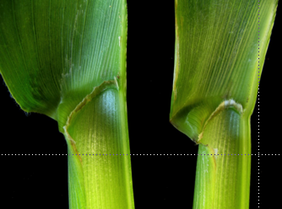
Lgn-R phenotype is suppressed in Mo17
B73 Lgn-R/+ Mo17 Lgn-R/+ (B73) (Mo17)
Notes:
The het phenotype is suppressed in Mo17 but the homozygous phenotype is not - thus in B73 it is a clear dominant, while in Mo17, it could be mistaken for a recessive

Slide 11
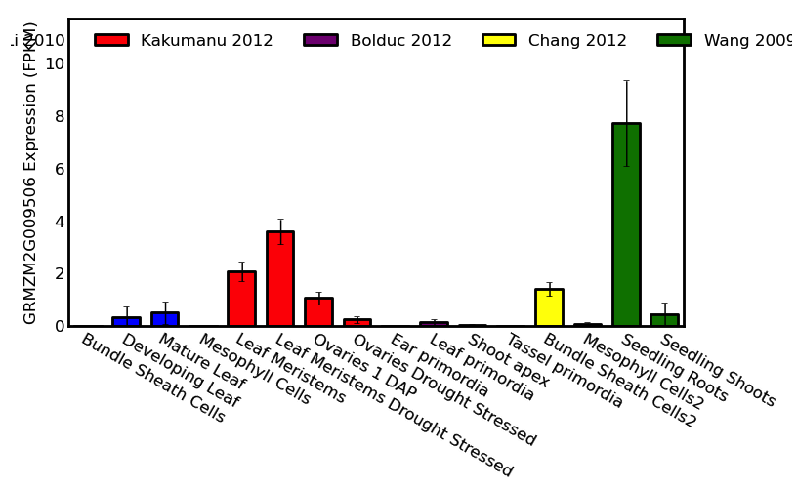
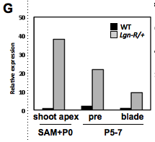
Duplicate gene is normally expressed at low levels in roots and not in shoots, but is expressed at high levels in Lgn-R mutants
Moon et al 2013
QTeller
Notes:
Add Qteller picture

Slide 12
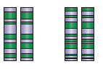
Used recombinant inbreds to identify a major QTL, then backcrossed to develop a near isogenic line (NIL)
Lgn-R
X
Lgn-R/IBM
chr 1 chr 9
B73
chr 1 chr 9
x B73
Sol-M
Lgn-R
Lgn-R
Rescued (Sol-Mo17) severe (sol-B73)
Sympathy for the ligule - Sol

Slide 13
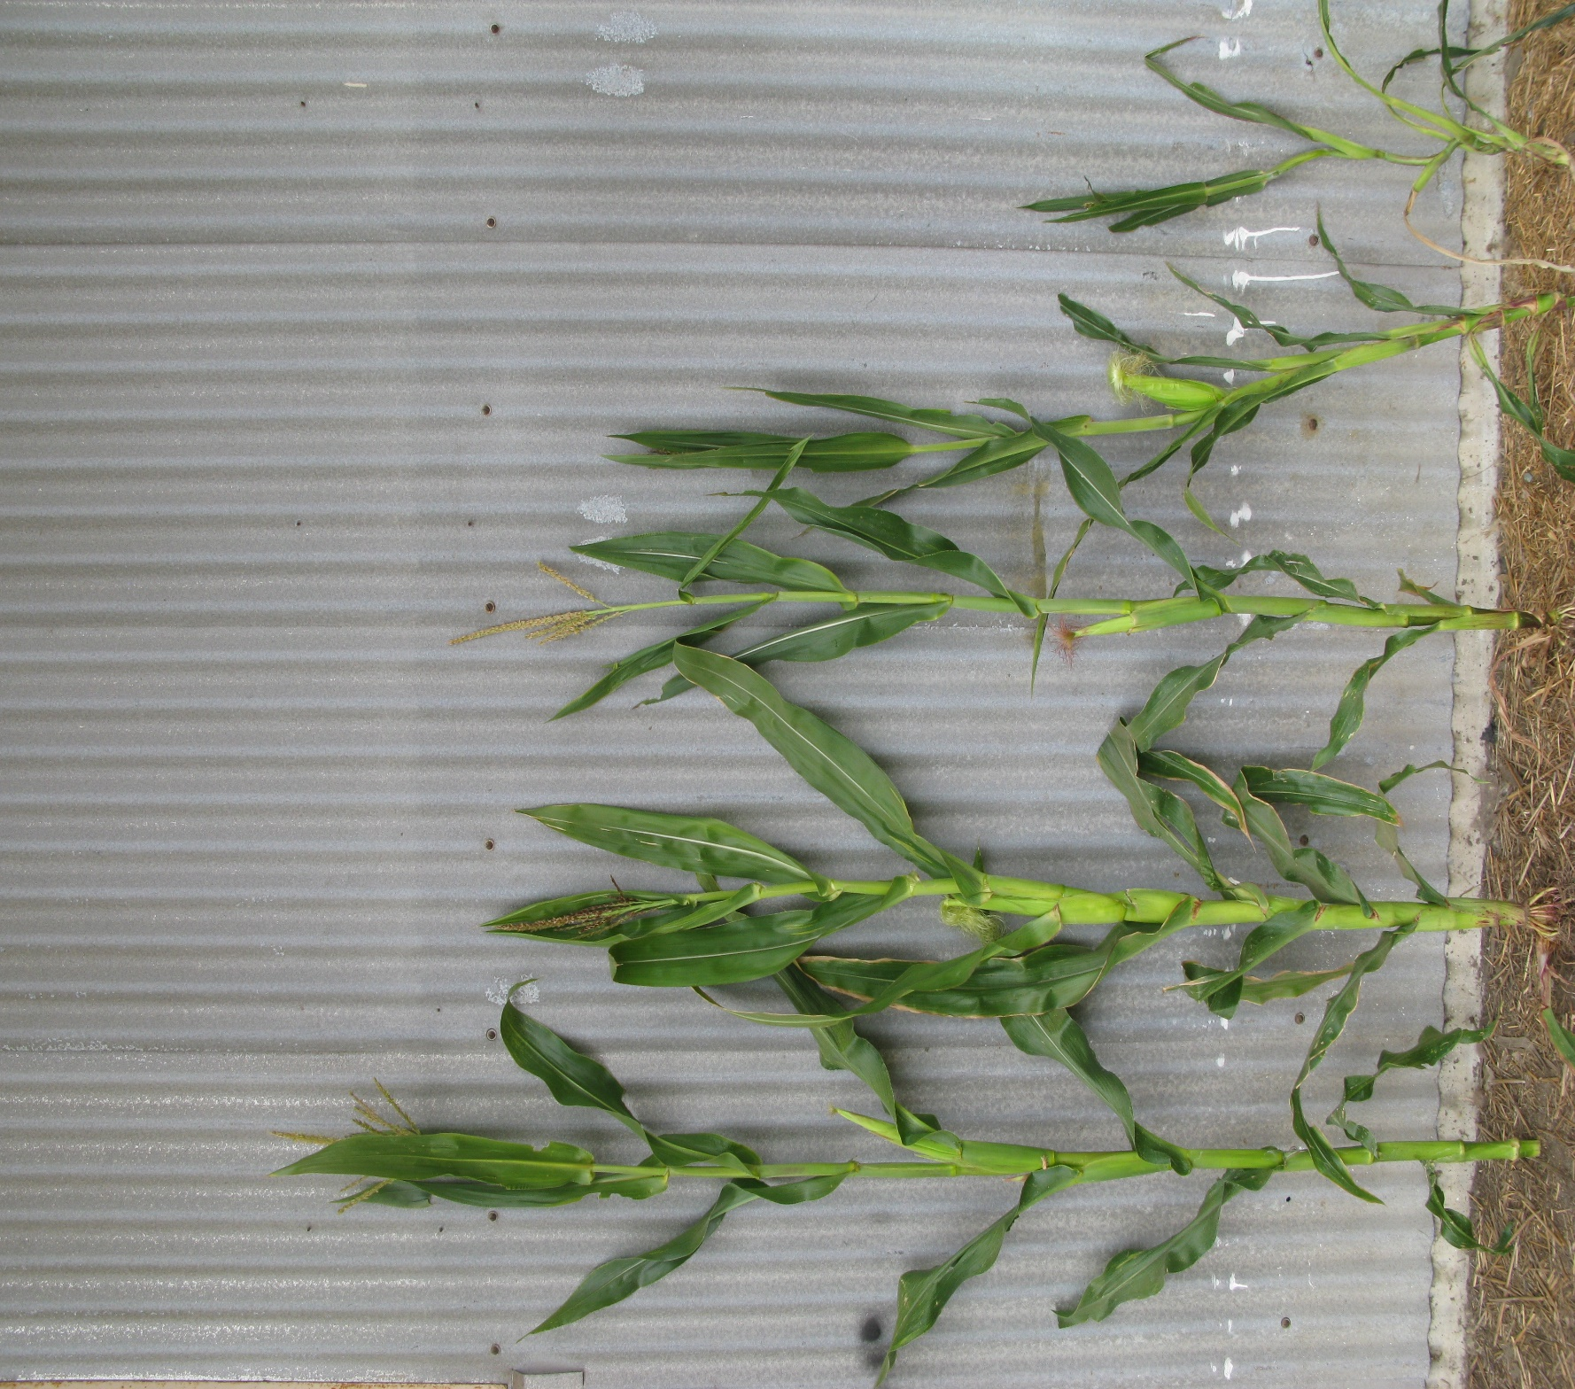
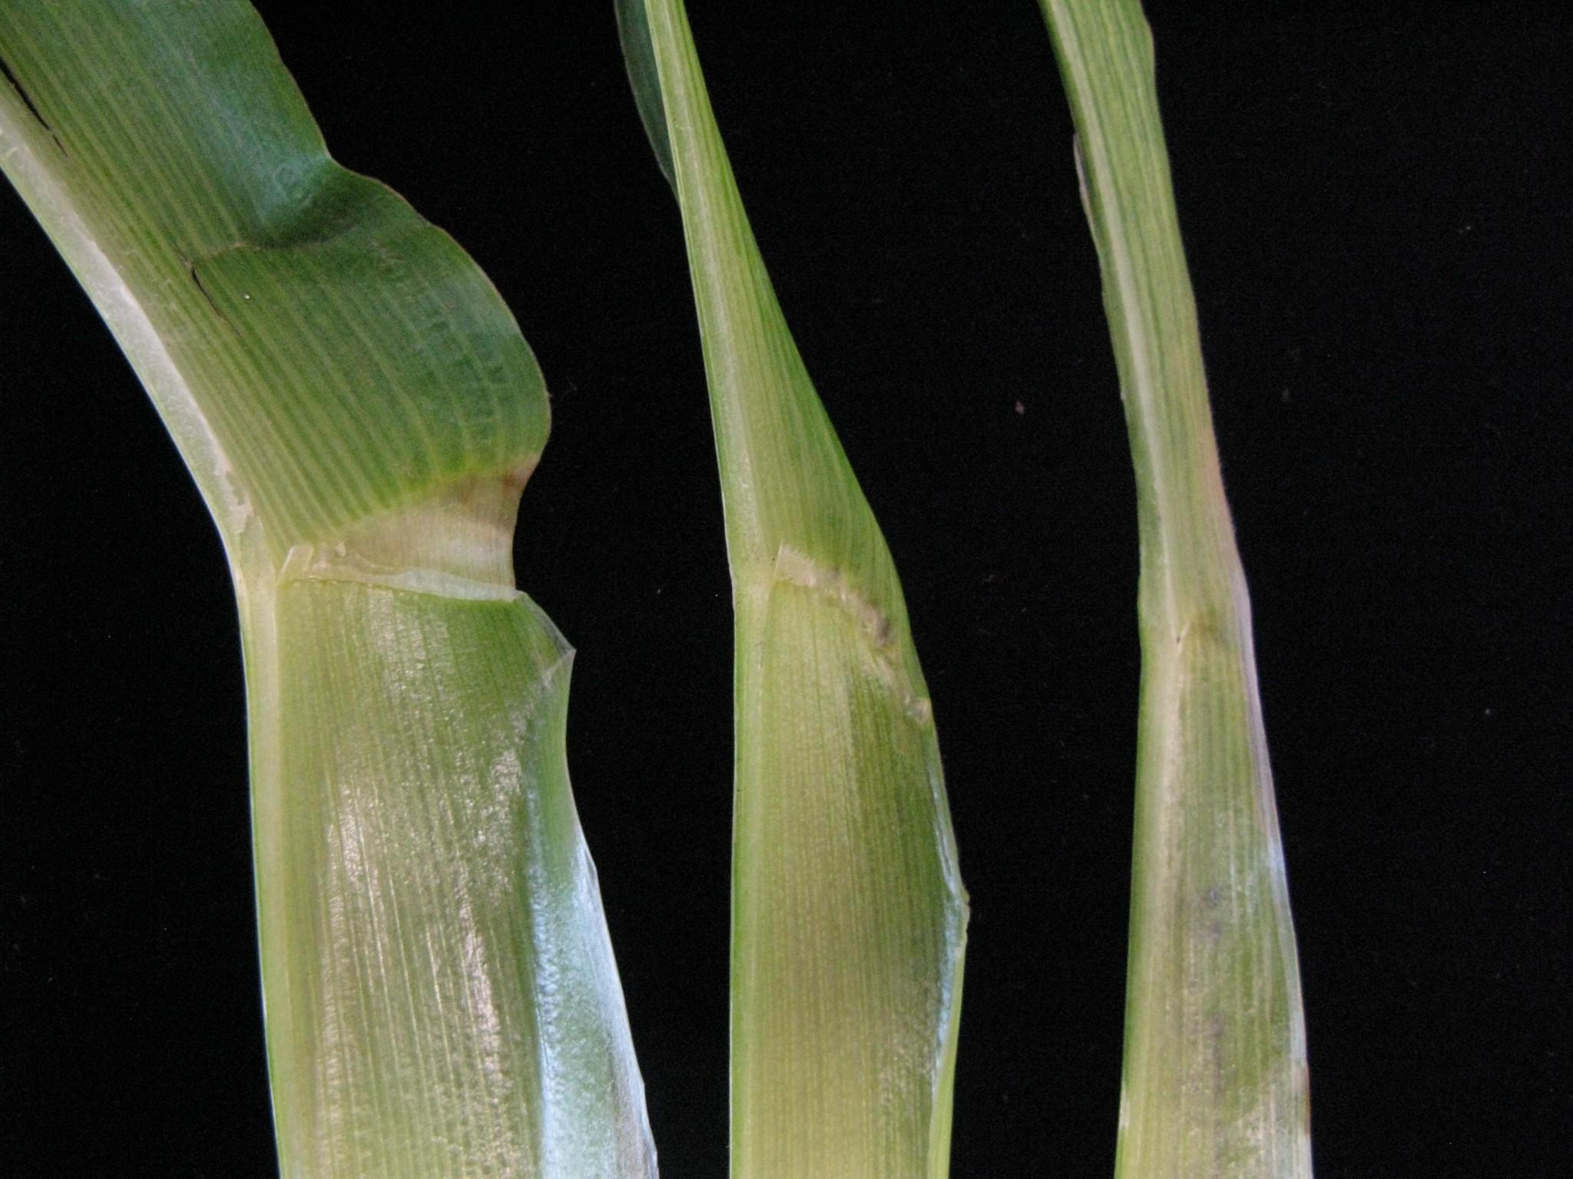
The NIL (Sol) Partially Rescues the Lgn-R/+ Phenotype
WT
Mo17
WT
B73
Lgn-R
Mo17
Lgn-R
NIL
WT
Lgn-R
B73
Lgn-R
NIL
Lgn-R
B73
Notes:
This is achieved by repeatedly backcrossing the hybrid to B73 while tracking the rescued mutant phenotype

Slide 14
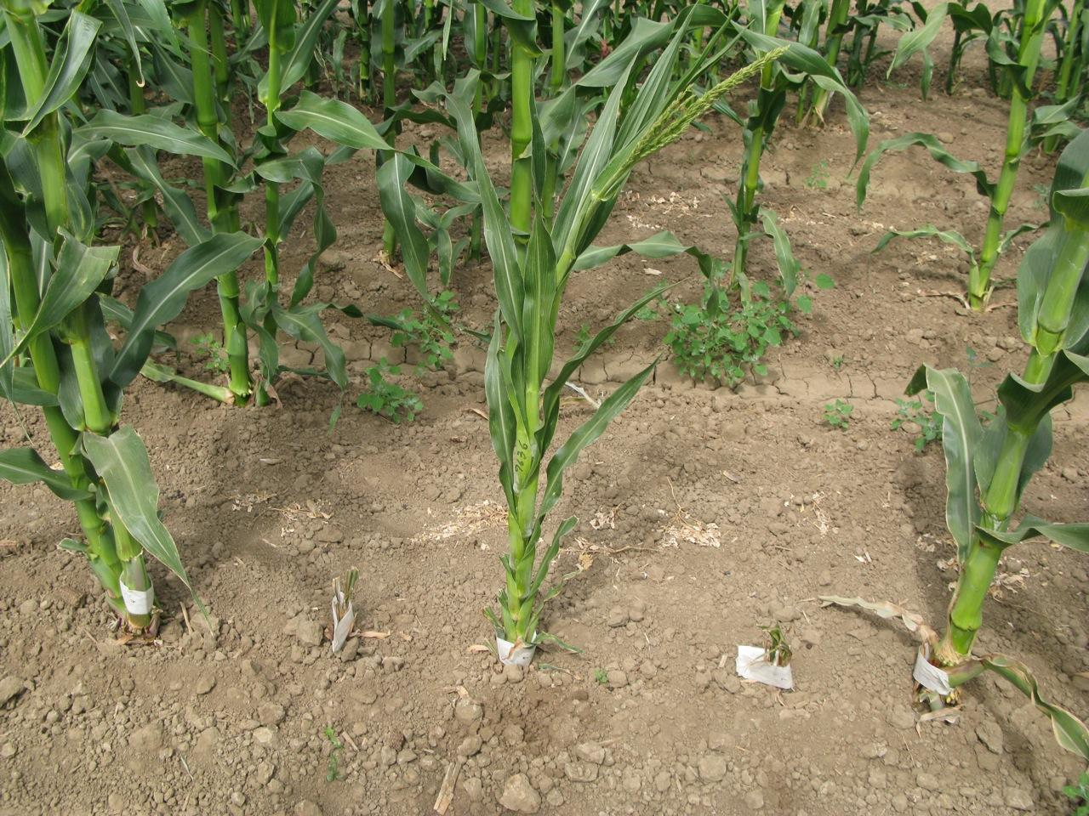
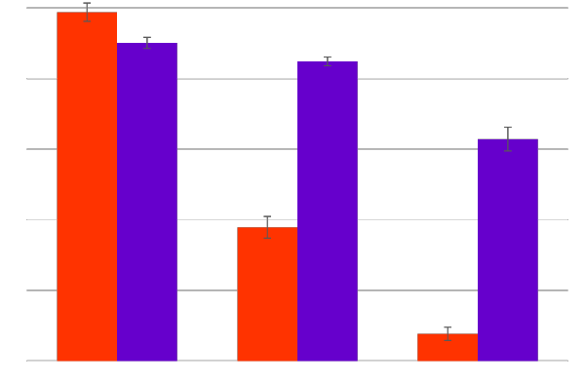
Lgn-R Plants Show a Genotype by Environment Effect
Average Plant Height In
Different Temperatures
Key
33◦C
250
23◦C
200
150
Plant Height (cm)
100
50
0
WT Lgn-R Lgn-R Lgn-R WT
B73 NIL B73
WT
Lgn-R
NIL
Lgn-R
B73
Notes:
An Additional Phenotype: Temperature Sensitivity
Occupy the farm

Slide 15
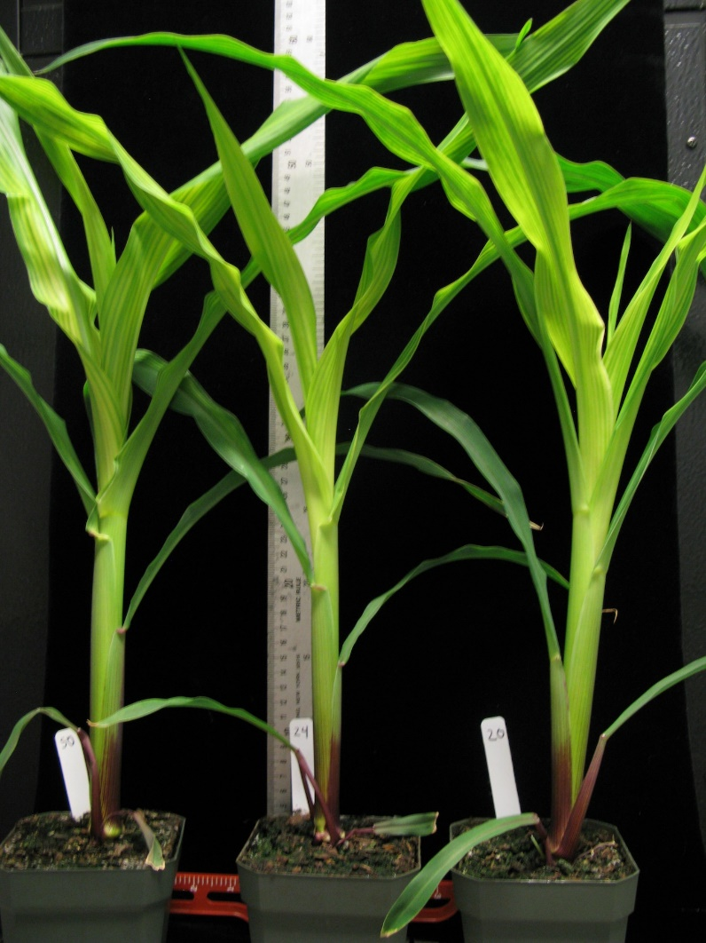
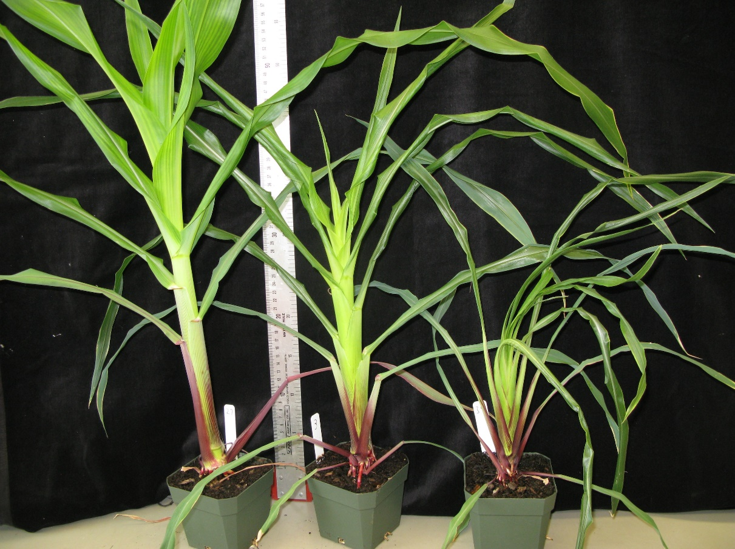
Lgn-R mutants suffer at higher temperatures in growth chamber
Cool temp (11C˚ night - 21C˚ day)
Warm temp (15C˚ night -32C˚ day)
WT
Lgn-R
NIL
Lgn-R
B73
WT
Lgn-R
NIL
Lgn-R
B73

Slide 16
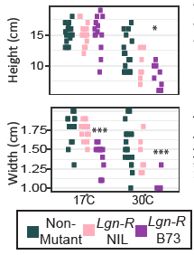
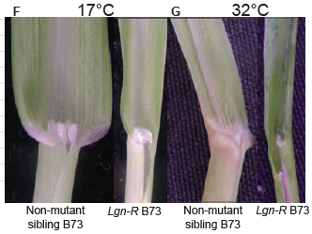
In contrast, cool temperatures make Lgn-R more like normal

Slide 17
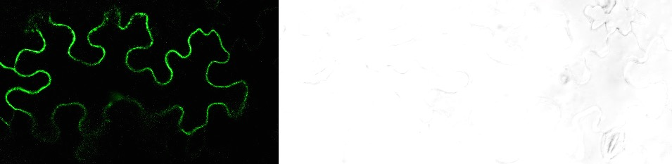
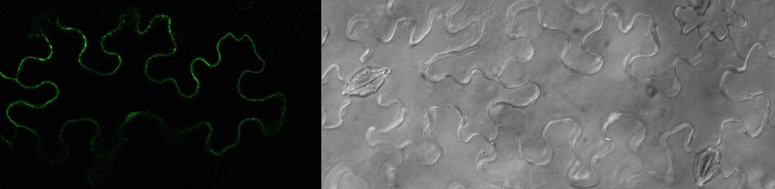
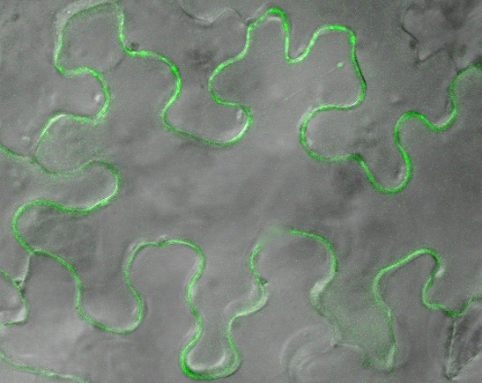
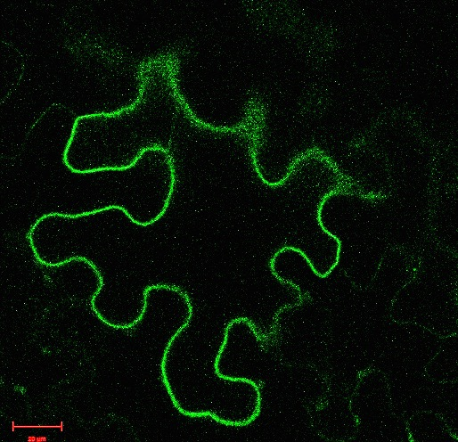
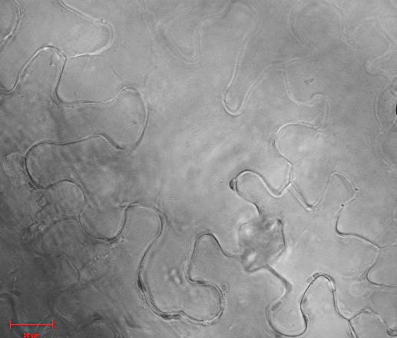
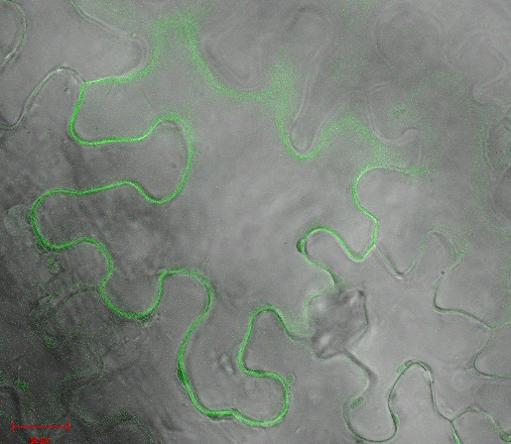
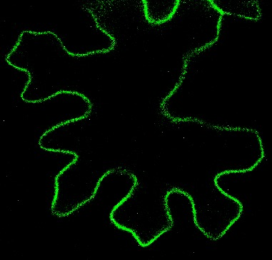
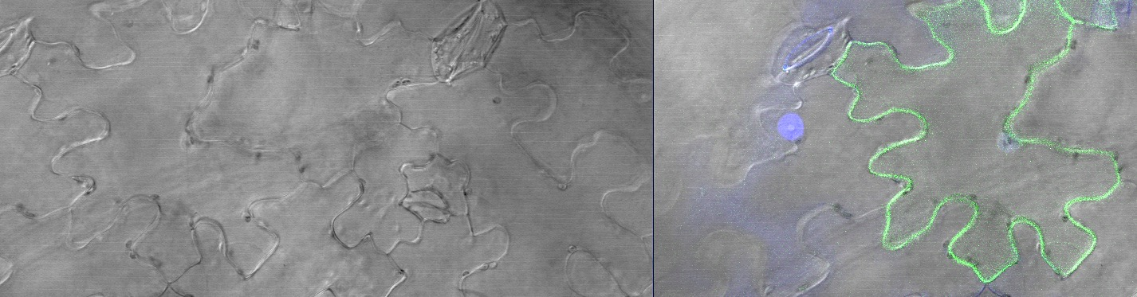


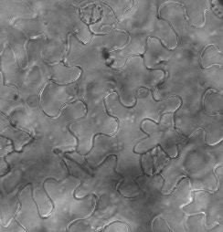
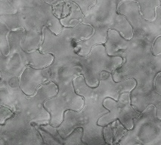
BiFC shows that NOD interacts with itself and with LGN, but not with the mutant version
YFPnNOD-YFPc NOD
20 µm
YFPnNOD-YFPc WNK
YFPnNOD-YFPc MSBP1
20 µm
YFPnNOD-YFPc LGN
20 µm
E
YFPnNOD-YFPc nod-2
YFPnNOD-YFPc nod-2
20 µm

Slide 18
LGN phosphorylates NOD in vitro
LGN
Lgn-R
NOD-P
Similar phospho sites as found in wild-type protein preps
NOD
Notes:
Two methods of detetion – fluorescent and radioactive

Slide 19
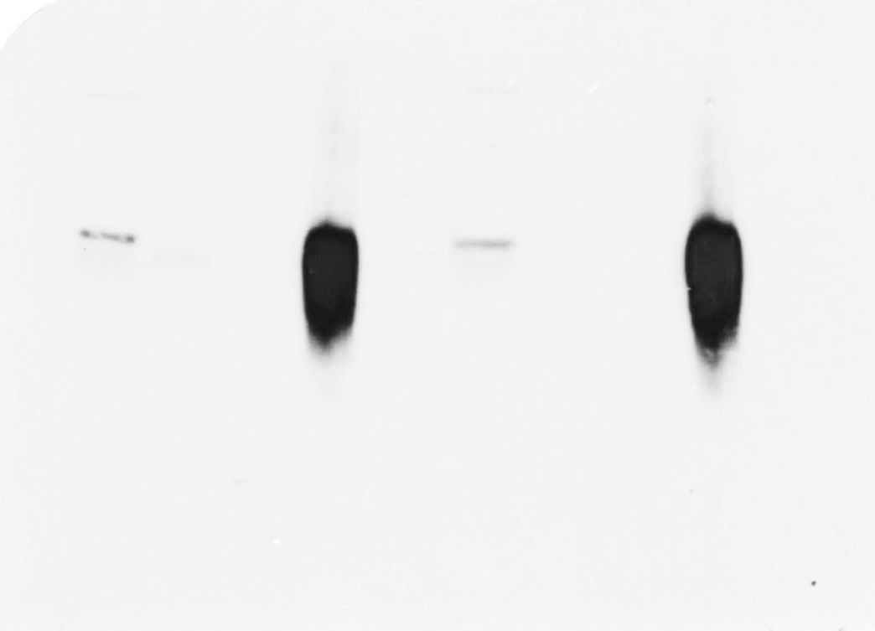
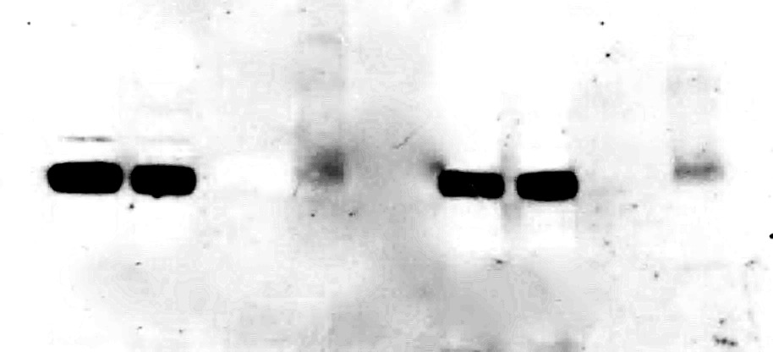
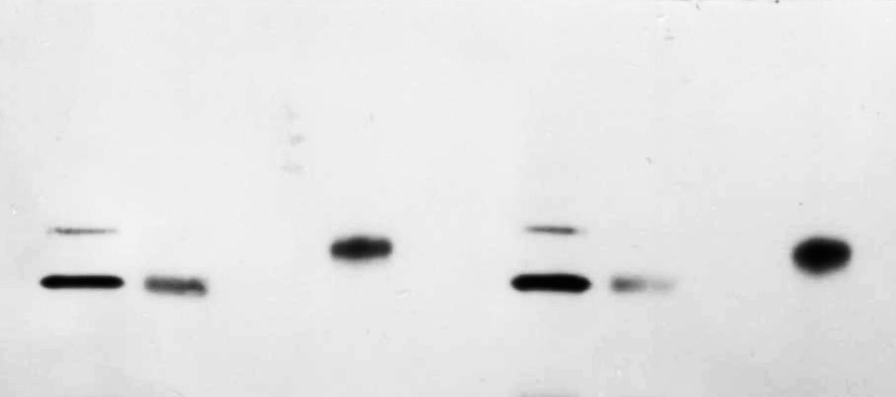
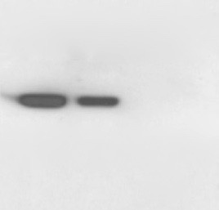
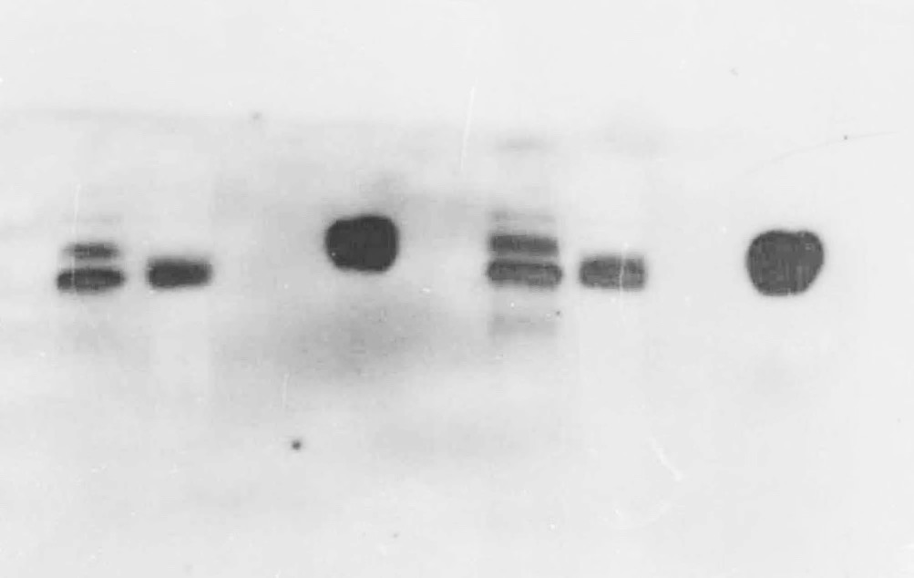
NOD Co-IP pulls down LGN and LGN Co-IP pulls down NOD
A
B
NOD CoIP
LGN CoIP
WT
Lgn-R
nod-1
WT
Lgn-R
Inp FT LW E Inp FT LW E
Inp FT LW E
Inp FT LW E Inp FT LW E
70-
55-
40-
35-
⍺ NOD
70-
55-
40-
35-
⍺ LGN
Notes:
Figure 2. Reciprocal NOD and LGN CoIP. A, NOD CoIP using a specific antibody against NOD in WT, Lgn-R and nod-1 plant tissue. Inp, Input of lysate protein, FT, Flow through, LW, Last washing, E, Elution. Western blot with Anti-NOD and Anti-LGN, respectively. No signal was detected in the E nod-1 mutant. B, LGN CoIP using an Anti-LGN specific antibody in WT and Lgn-R plant tissue. Western blot with Anti-LGN and Anti-NOD, respectively.
Note – Jazmin is going to try and repeat the panel in B.

Slide 20
Asked what does double mutant look like
Carried out crosses in A619 where nod has a mild phenotype (a narrow odd dwarf) and Lgn-R is nearly normal

Slide 21
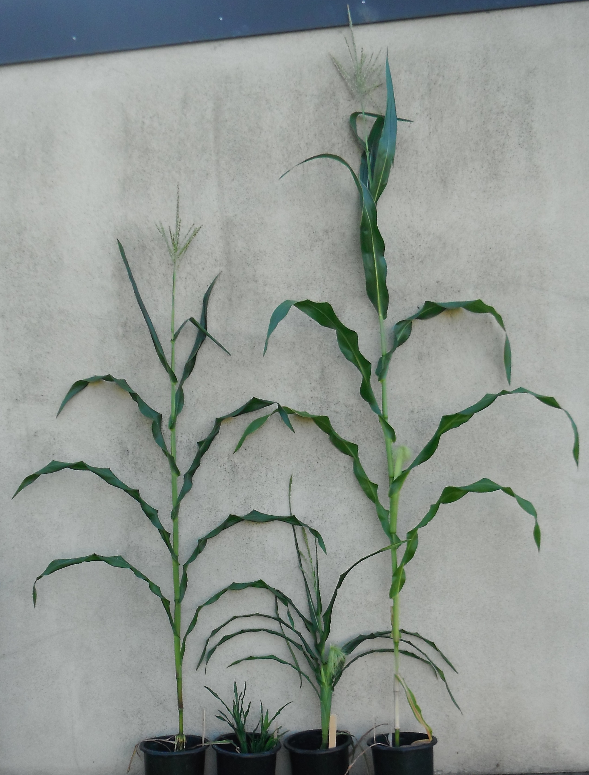
Lgn-R double nod normal
The double in A619 looks like Lgn-R homozygote or nod homozygote in B73
Results suggest that they have different rescuing modifiers and in double mutant, the modifiers are ineffective
Notes:
Ineffective or incompatible
Or maybe they fail to compliment

Slide 22
Lgn-R/nod double mutant population
Key
nod
Lgn-R
Double mutant
Non-mutant sibs
Plotted height and leaf width

Slide 23
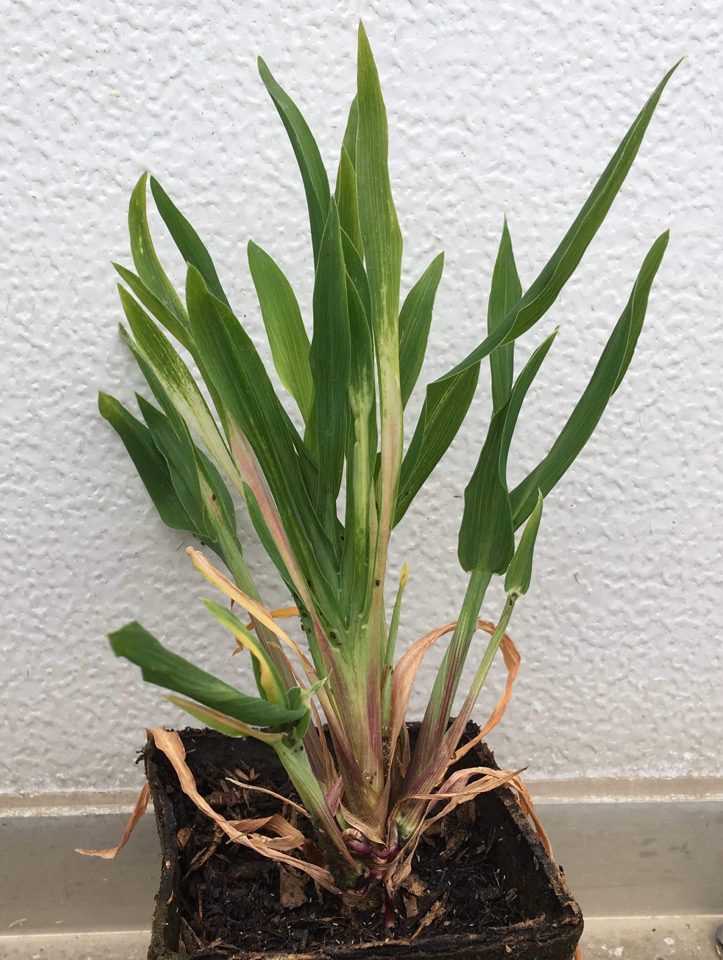
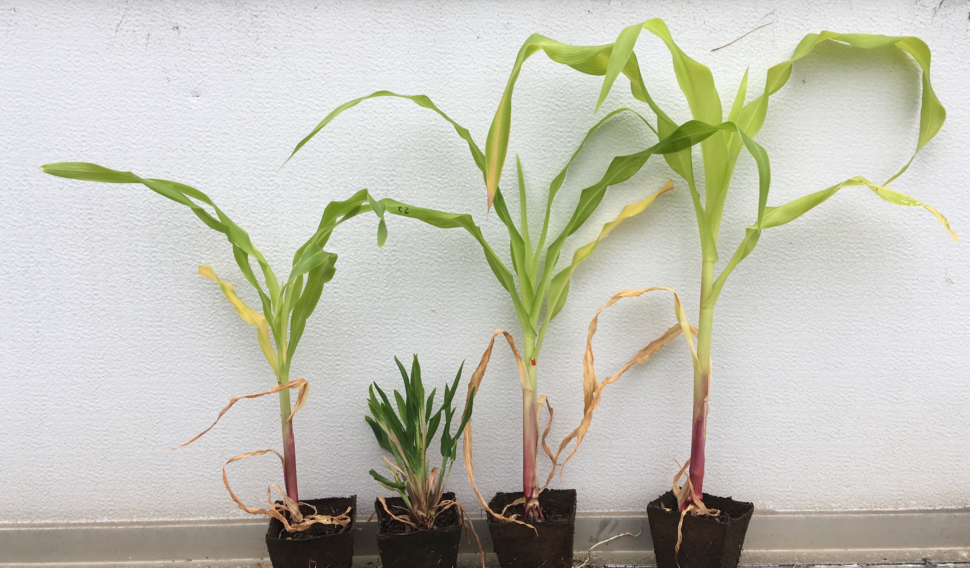

Figure 5
A
B
Lgn-R/+; nod
A619
D
Lgn Lgn/nod nod WT
C
E
Lgn-R/Lgn-R
Lgn-R/+; nod
WT
Lgn-R/+
nod
Lgn Lgn/nod nod WT
Notes:
Figure 5. Phenotypes of single and double mutants from a cross of Lgn/+; nod/+ x nod/nod in the A619 mutant (2313-38 x 2308). A). Examples of the mature plants grown in the greenhouse. B) leaf width and plant height at maturity of field-grown individuals. C). Immature phenotypes of individuals from the same family analyzed in panels A and B. These were the size of plants used for RNAseq. D) close-up of double mutant at 6 weeks. E) Mature leaf from the following genotypes: non-mutant sibling, Lgn-R/+ (2314), Lgn-R/Lgn-R (2313), Lgn-R/+;nod-1/nod-1 (2313), nod-1/nod-1 (B73).

Slide 24

Normal leaf development
Propose that LGN and NOD have dual functions – promote leaf development and keep immunity in check
Notes:
Because no immunity mutant has ligule defect and these plants do not have HR

Slide 25
Lgn-R
SOL-B
LNL
In Lgn-R mutant in B73, failure to phosphorylate targets, Sol-B transcripts up, PTI increases, abnormal leaf development
Notes:
Add picture of Lgn sol-B

Slide 26
Lgn-R
SOL-B
SOL-M
Normal leaf development
Even with 1 copy of Sol-M, SOL-B is reduced, leaf is more normal and PTI is reduced
Suggests that SOL-M may interact with different proteins than SOL-B
Notes:
Add picture of Lgn sol-M

Slide 27
In nod mutant,
ETI is activated but LGN still keeps brakes on PTI
Notes:
Add picture of Lgn sol-M

Slide 28
In double mutant mutant,
ETI and PTI are activated and modifiers not able to rescue plant
Lgn-R
Notes:
Add picture of Lgn sol-M

Slide 29
Take away lesson
Cross your mutants to different inbreds
You never know what you might discover
Notes:
Plan to determine what SOL interacts with in B73 versus Mo17, where Sol-M is localized.

Slide 30

Alyssa Jazmin Marisa
Sam
Funding
ARS - positional cloning
NSF - ligules
NSF - drought & inflorescences
Celebrating maize genetics on the farm

Slide 31
Present lab members
China Lunde Ts5 and JA
George Chuck tillers
Zhaobin Dong tillers
Angus Vajk sex determination
Alyssa Anderson LGN and SOL
Jake Brunkard cell biology
Annis Richardson leaf development
Sam Leiboff sorghum, maize networks
Martin Alexander tassel development
Brianna Haining iron uptake in Setaria
Recent members
Jazmin Abraham Juarez proteomics
Mike Lewis lg1, lg2, wab
Marisa Rosa nod
Katsutoshi Tsuda KNOX and BEL
Collaborators
Leaf collaborators: Anne Sylvester, Mike Scanlon, Robyn Johnston, Rico Coen, Pat Brown
Inflorescence collaborators: Erik Vollbrecht, Dave Jackson, Jose Dinneny, Andrea Eveland, Torbert Rocheford
Funding
ARS - positional cloning
NSF & BBSRC - leaf modeling
NSF - leaf & inflorescence

